Slide 1
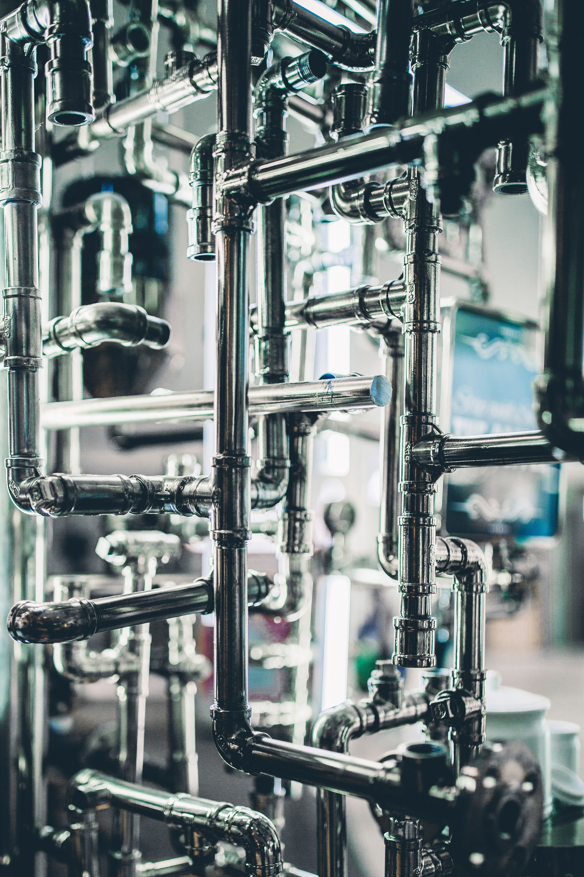
Nimmy Francis
Assistant Professor
Expert Homecare
MATHEW PETER
INT MCA S9
AJC20MCA-I044

Slide 2
Agenda
Project overview
Types of users
Features
System Design
Implementation
UML Diagrams
Screenshots

Slide 3
01
Project Overview

Slide 4
This project introduces an advanced online platform for home maintenance and repair services, including plumbing, electrical work, and electronic gadget repairs.
Users can easily select their desired services and access detailed profiles of qualified service providers, which can be sorted by experience and region.
Each profile features information on qualifications, years of experience, and authentic customer reviews to ensure informed decision-making.
The platform is committed to delivering exceptional quality of service, prioritizing customer convenience and satisfaction.
Accessible via both desktop and mobile devices, the platform aims to streamline the booking process for users in the districts of Ernakulam and Kottayam.

Slide 5
02
Types Of Users

Slide 6
Customer
Login/registration.
View and update profile.
View and book Service
Pay for Service after Service Done.
Track Service status.
Provide feedback after Service completion.
Manager
Login
View and update profile.
Add, Edit and Delete Service
Add, Edit and Delete Service Provider
Manage Booking Details
View Feedback
.
Admin
User Management.
Add, Edit and Delete Service
Add, Edit and Delete Service Provider
Add, Edit and Delete Manager
Manage Booking Status.
View Payment Details
View Feedback Details
Service Provider
Login
View Booked User Details
Mark has service done or not
Initiate Payment
View booking details service provider done
View and update profile
Send feedback form

Slide 7
Features
Users can create accounts for personalized access, manage profiles, and securely log in.
Browse a service and select a service provider and give a small description of the problem
Book service with specify the date and time slot
Users queries can be solved by using chat person
After the service is done the service provider initiate the payment
Administrators manage user accounts, booking details, service provider details
Managers can track booking details and can solve any booking related queries

Slide 8
03
System Design

Slide 9
Figma Design
Figma is a web-based tool that allows multiple users to design interfaces, create reusable components, and prototype interactions in real-time.
With features like Auto Layout, shared styles, and a component system, Figma helps maintain design consistency and responsiveness across different screen sizes.

Slide 10
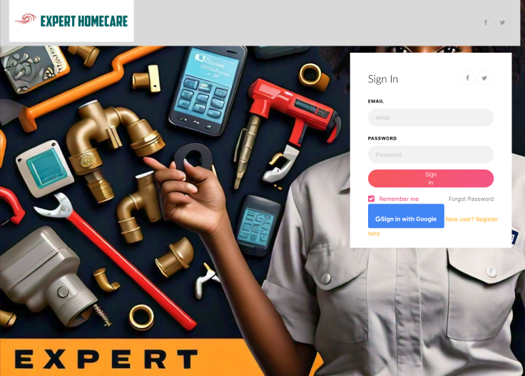
Login Page Design using figma

Slide 11
04
Implementation

Slide 12
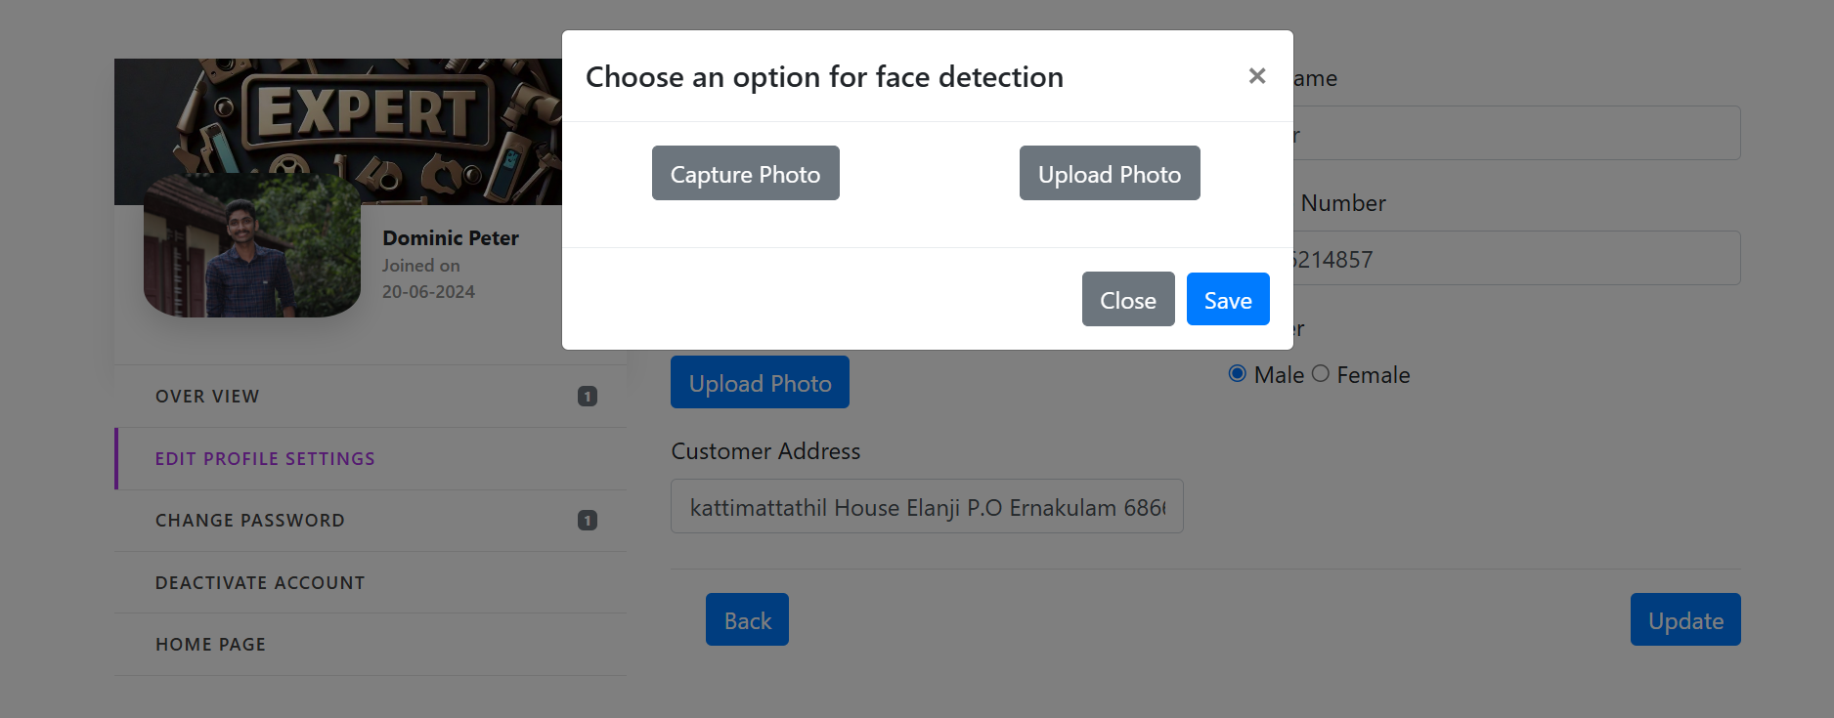
Face Detection

Slide 13
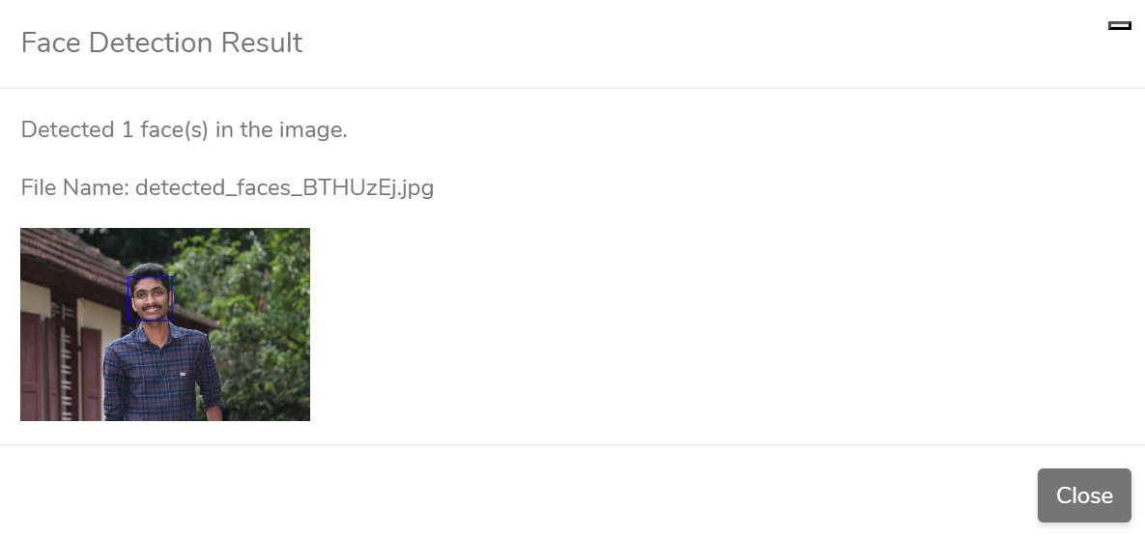
Face Detection Result

Slide 14
05
UML Diagrams

Slide 15
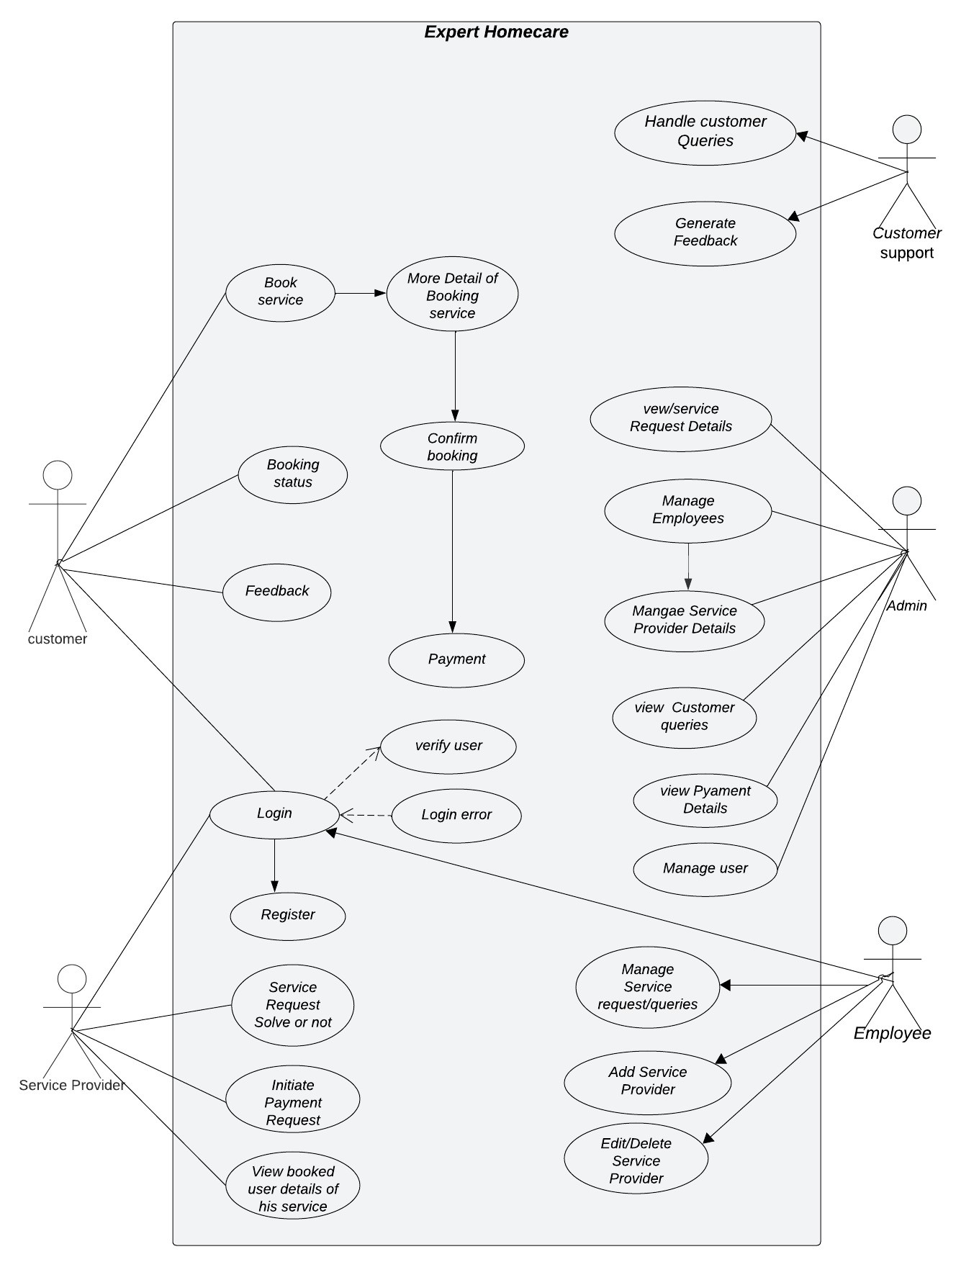
Use case Diagram

Slide 16
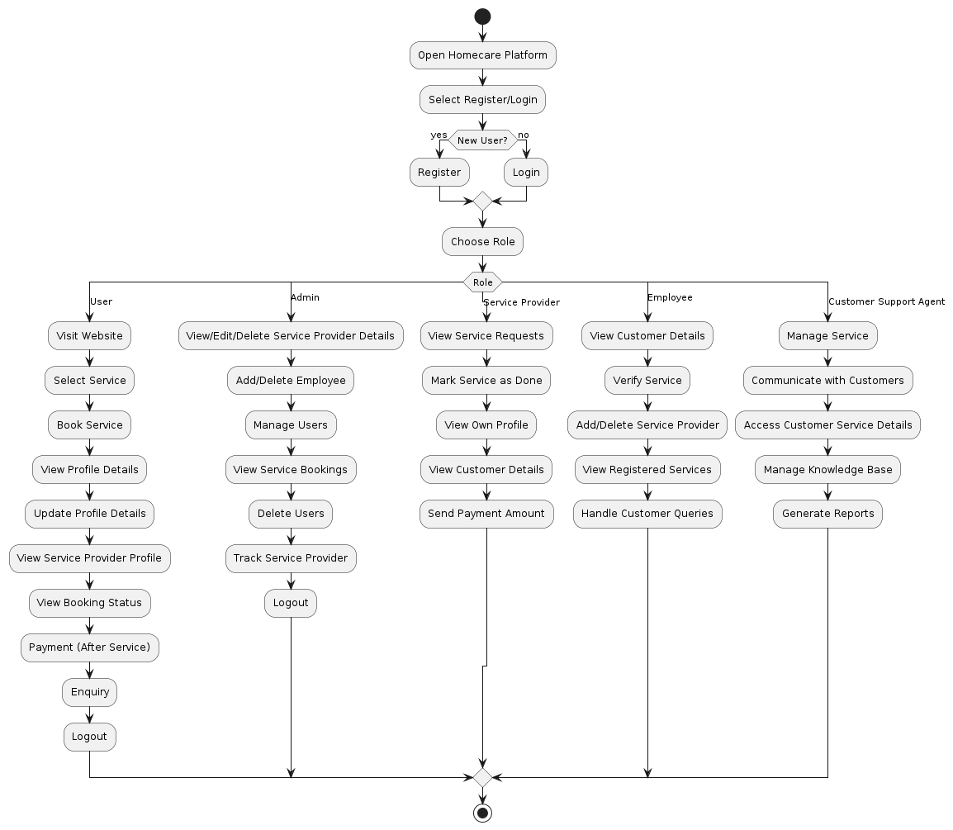
Activity Diagram

Slide 17
Conclusion
This project presents an advanced, user-friendly online platform that streamlines home maintenance and repair services—spanning plumbing, electrical work, and electronic gadget repairs—enabling customers in Ernakulam and Kottayam to book expert services with ease and confidence. With detailed profiles showcasing each service provider’s qualifications, experience, and verified customer reviews, the platform empowers users to make informed choices tailored to their specific needs and preferred schedules.

Slide 18
06
Screenshots

Slide 19
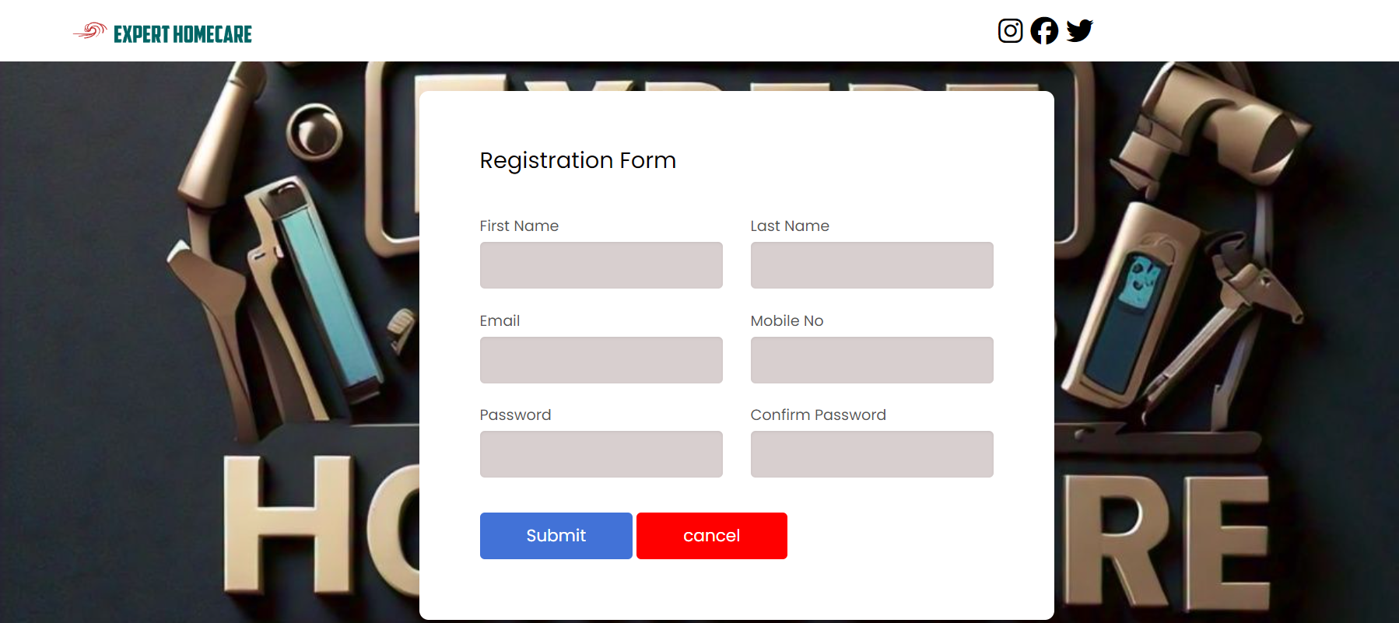
Registration Form

Slide 20
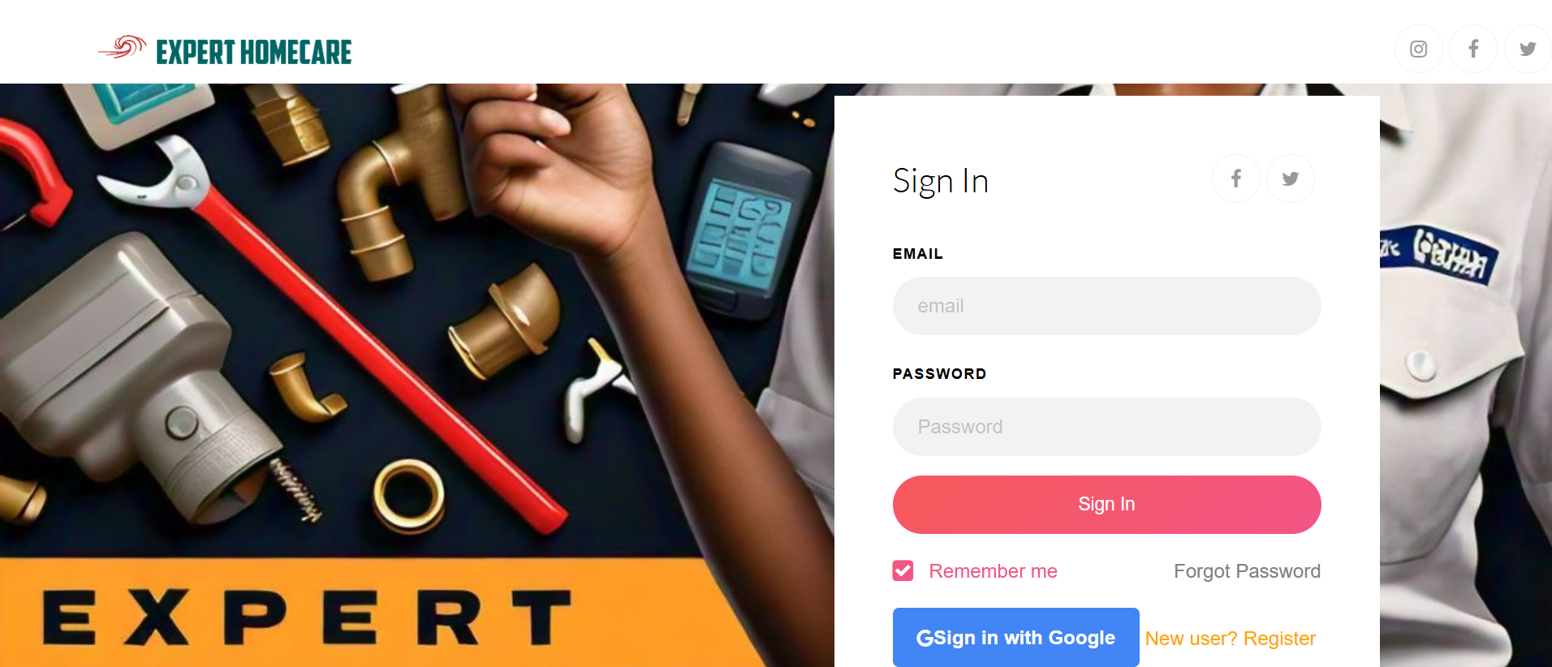
Login Page

Slide 21
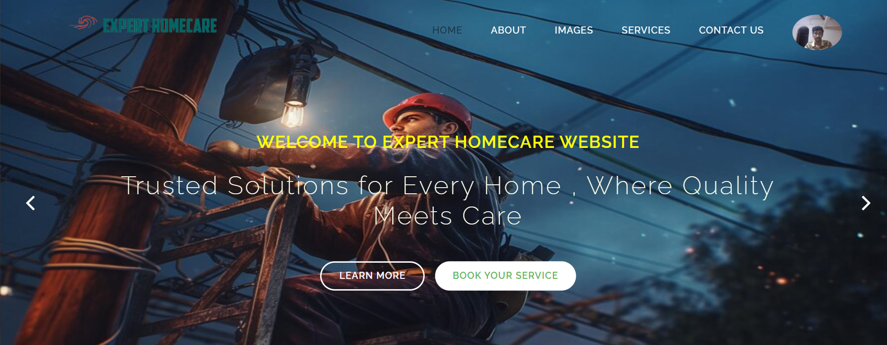
Home Page

Slide 22
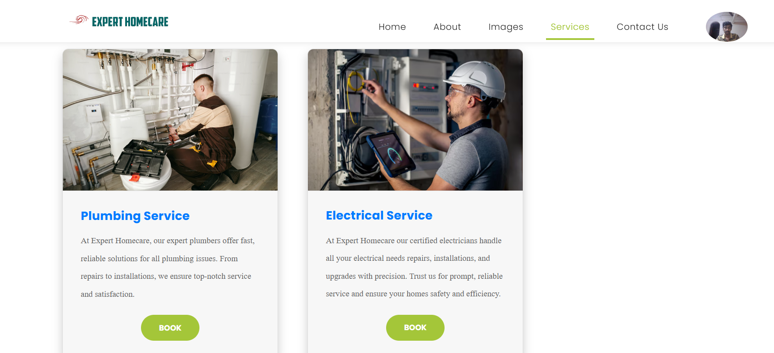
User Service Page

Slide 23
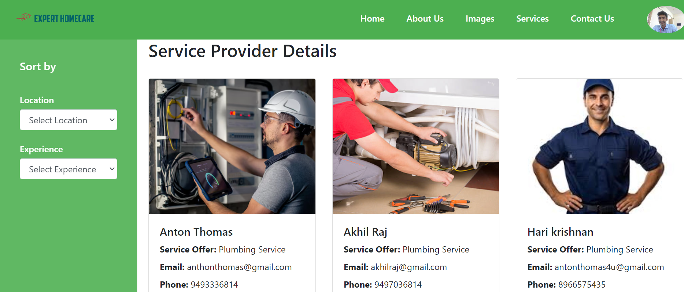
User Service Provider Page

Slide 24
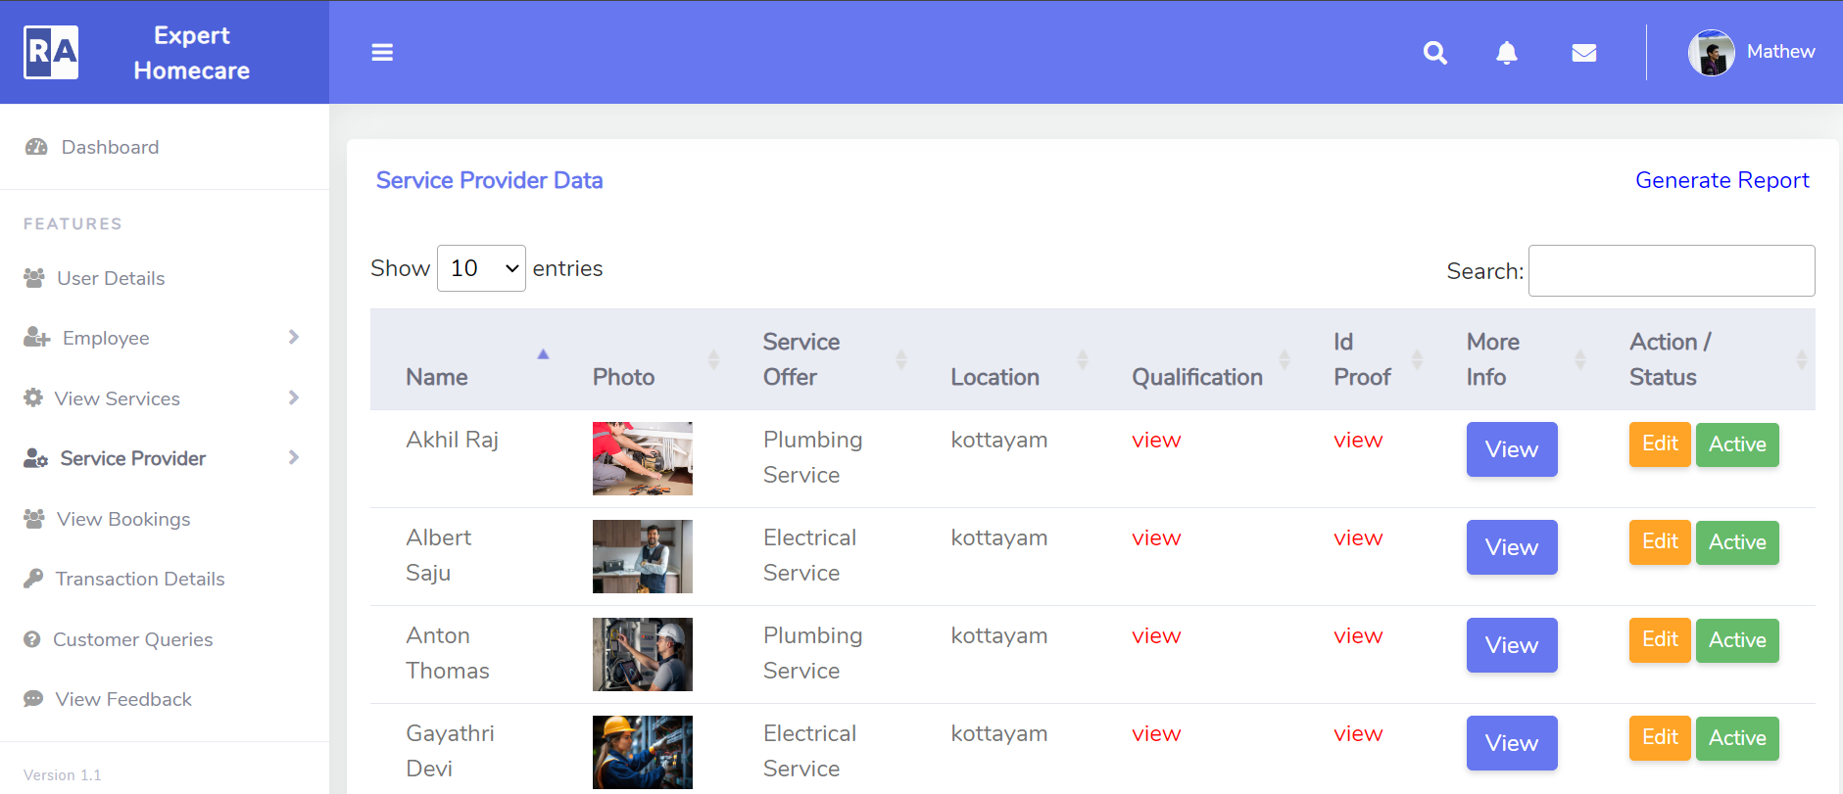
Admin Service Provider Page

Slide 25
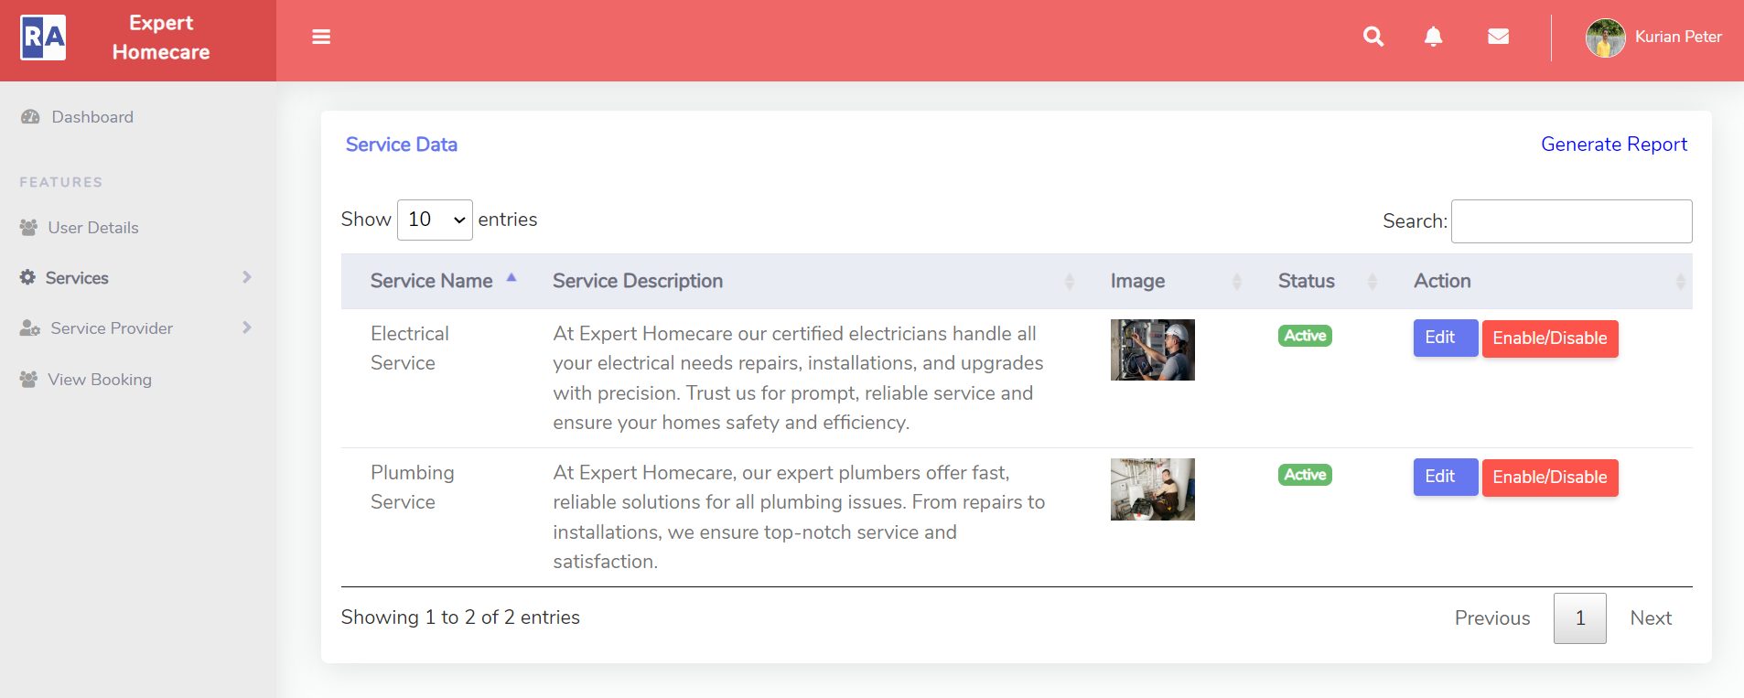
Manager View Service Page

Slide 26
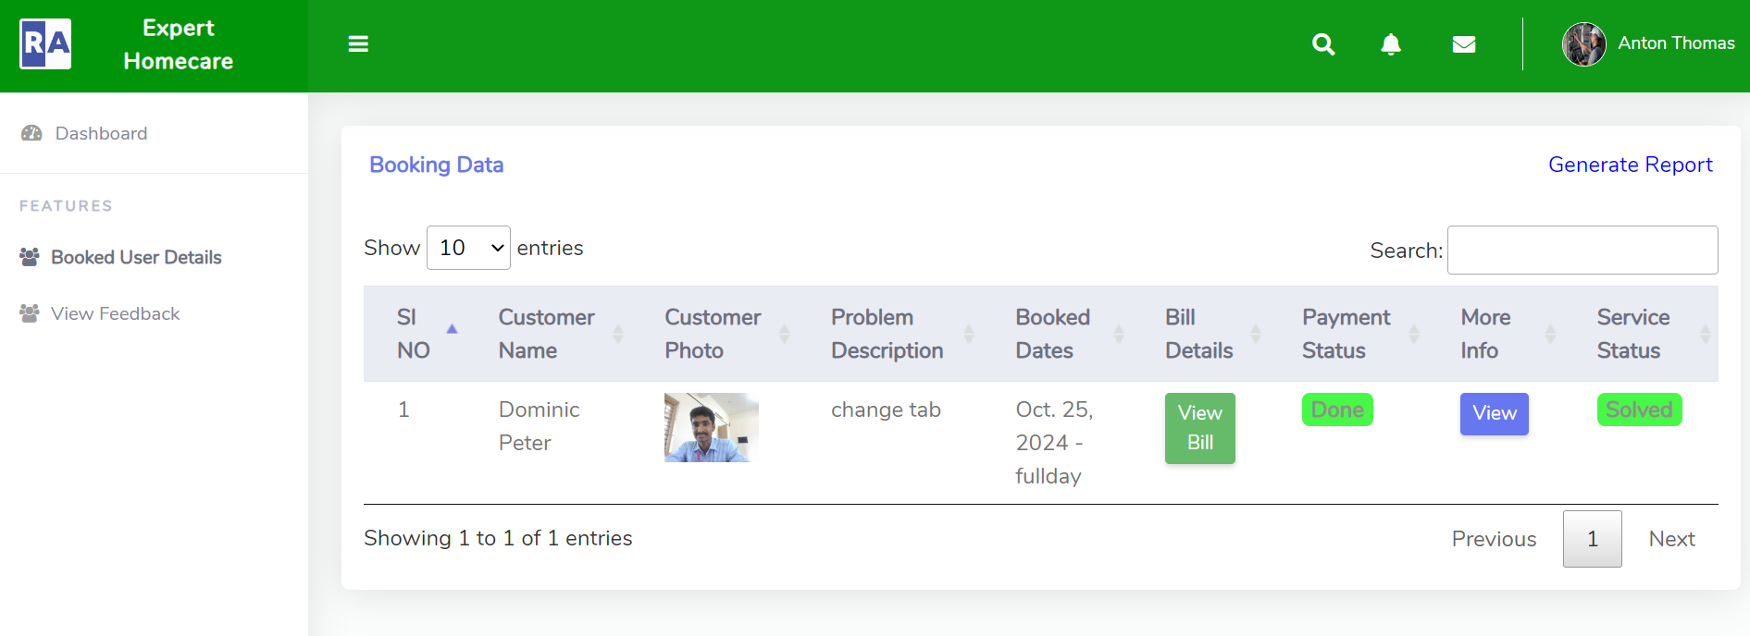
Service Provider Booked User Details

Slide 27
Thank You

